Slide 1

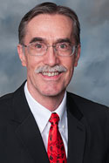
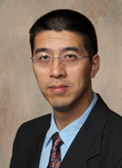
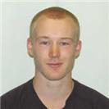
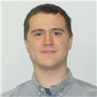
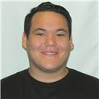

2. A First-Year Computer Engineering Lab Project: Driving an LCD with an FPGA Embedded Processor
Two Papers:
1. A First-Year Electronics Lab Project:
Design of Basic Voltmeter plus Soldering Tutorial
Rod Foist, Xuping Xu, Timothy Gage, Seth Truitt, and Matthias Schmidt
Katmal National Park, Alaska

Slide 2
Outline
Recent NSF Educational Research—Using Labs Strategically
  Adapting the “Spiral” curriculum model
External Collaborators with the PI—Testing Labs
Preliminary Results
Inspired to Create Labs for the Spiral Model
  A Voltmeter + LCD Laboratory Project
  An FPGA + LCD Lab Project
Code + Instructions—Available Online
Conclusions + Q&A
FYEE 2018, Dr. Rod Foist

Slide 3

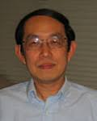


Recent National Science Foundation (NSF) research is aimed at improving the Electrical and Computer Engineering (ECE) curriculum across all four years…
Principal Investigator
Dr. Pong Chu
(Cleveland State University)
Goal: Enhance student learning and prepare graduates to meet new challenges
Method: Make strategic use of lab projects within a “spiral” model
External Collaborators: We tested new lab projects in existing courses
FYEE 2018, Dr. Rod Foist

Slide 4

The spiral model is based on an earlier 5-year study of engineering education*
The study found a deficiency in the curricula: subjects are taught in isolation, without proper context, and do not adequately prepare students to integrate that knowledge.
In addition, labs were not used effectively.
←Dominant curricular model:
building blocks or linear components
FYEE 2018, Dr. Rod Foist
* Educating Engineers: Designing for the Future of the Field, by Sheri D. Sheppard et al., Carnegie Foundation, 2009

Slide 5
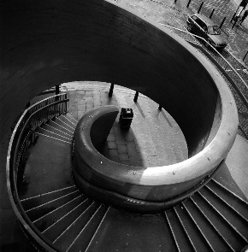
Spiral model ... (continued)
That study recommended a “spiral model” and effective use of labs (as design projects):
“… the ideal learning trajectory is a spiral, with all components revisited at increasing levels of sophistication and interconnection. Learning in one area supports learning in another.”
FYEE 2018, Dr. Rod Foist

Slide 6
Chu’s research applies/combines the spiral model + effective use of labs + 3 component themes
He uses the spiral model by introducing certain lab component themes (in the freshman year) and lays out a plan to revisit them with increased sophistication and interconnection in the following years.
Labs are used as a “cohesive framework” that connects and integrates individual courses.
3 themes used—video (and image), sound, and touch sensors.
FYEE 2018, Dr. Rod Foist

Slide 7
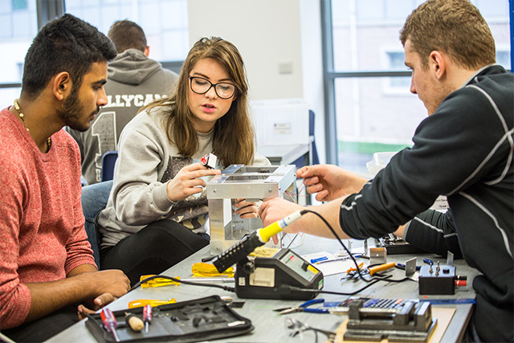
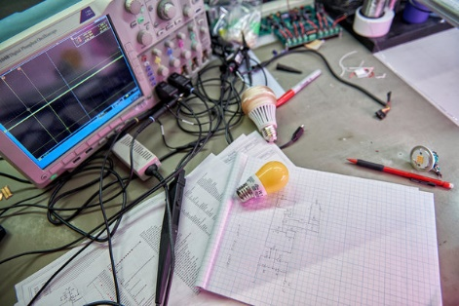
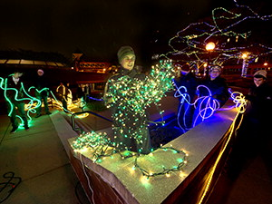
We were “external collaborators” for Chu—trying out some themed labs in a few existing courses for 2 years
…a 2nd year digital logic design course
…a 3rd year microcontroller course
…a senior course in advanced digital design
…our IEEE student club.
A “theme” example:
students are exposed to lab projects using visual feedback (LEDs and LCDs) in all four years—but with more complexity introduced in each year.
FYEE 2018, Dr. Rod Foist

Slide 8

Preliminary results—student survey: selected questions
1) The lab work I do for this course is relevant to my learning,
3) The labs for this course show me how to problem-solve in ECE,
4) The labs in this course make the content more understandable,
6) Doing the labs shows me real life applications of the information.
Possible responses (with numerical values) were: Strongly Agree (5), Agree (4), Undecided (3), Disagree (2), Strongly Disagree (1). Table 1 summarizes the data.
FYEE 2018, Dr. Rod Foist

Slide 9
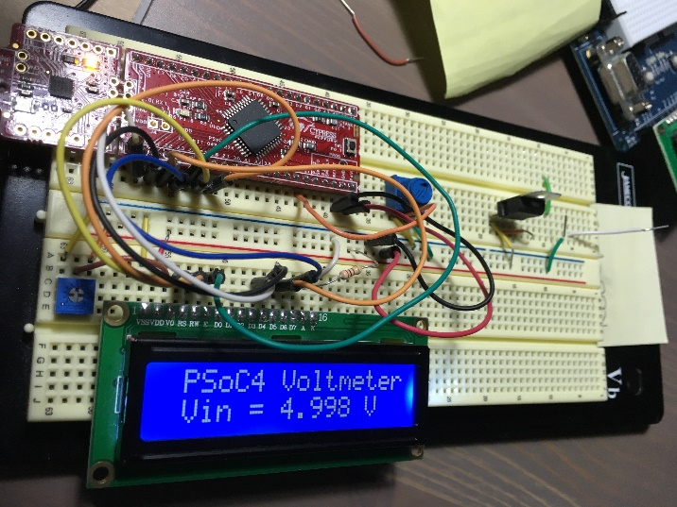
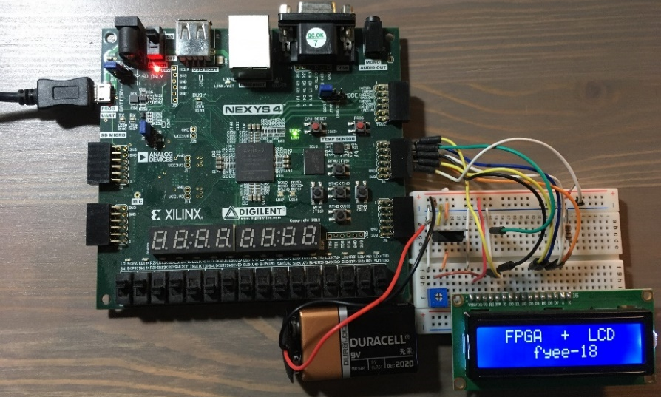
Inspired to create 2 user-friendly labs for the spiral model—image theme
A First-Year Electronics Lab Project:
Design of Basic Voltmeter plus Soldering
Tutorial
A First-Year Computer Engineering Lab Project: Driving an LCD with an FPGA Embedded Processor
Both projects use a liquid crystal display (LCD)—an important “component” that can be re-visited in following years with more sophistication and interconnection.
More-detailed instructions + project code are available online, per the papers:
https://bitbucket.org/CBUCoEFYEE2018
FYEE 2018, Dr. Rod Foist

Slide 10
Conclusions + Q&A
Dr. Chu’s NSF research:
Employs the recommended spiral curriculum model from an earlier Carnegie scholars’ 5-year study
Makes strategic use of laboratory projects as a cohesive framework for individual courses
Resulted in a 2nd edition of his popular ECE book with spiral model lab projects included
Was partly tested by us—and showed favorable student results at CBU
Our work inspired us to:
Create 2 spiral themed projects—with preliminary favorable student results
  *** The contribution of these papers: provide a fully-working, easy-to-use, first-year lab project within the video/image theme of the spiral model approach to improving the ECE curriculum.
FYEE 2018, Dr. Rod Foist

