Slide 1
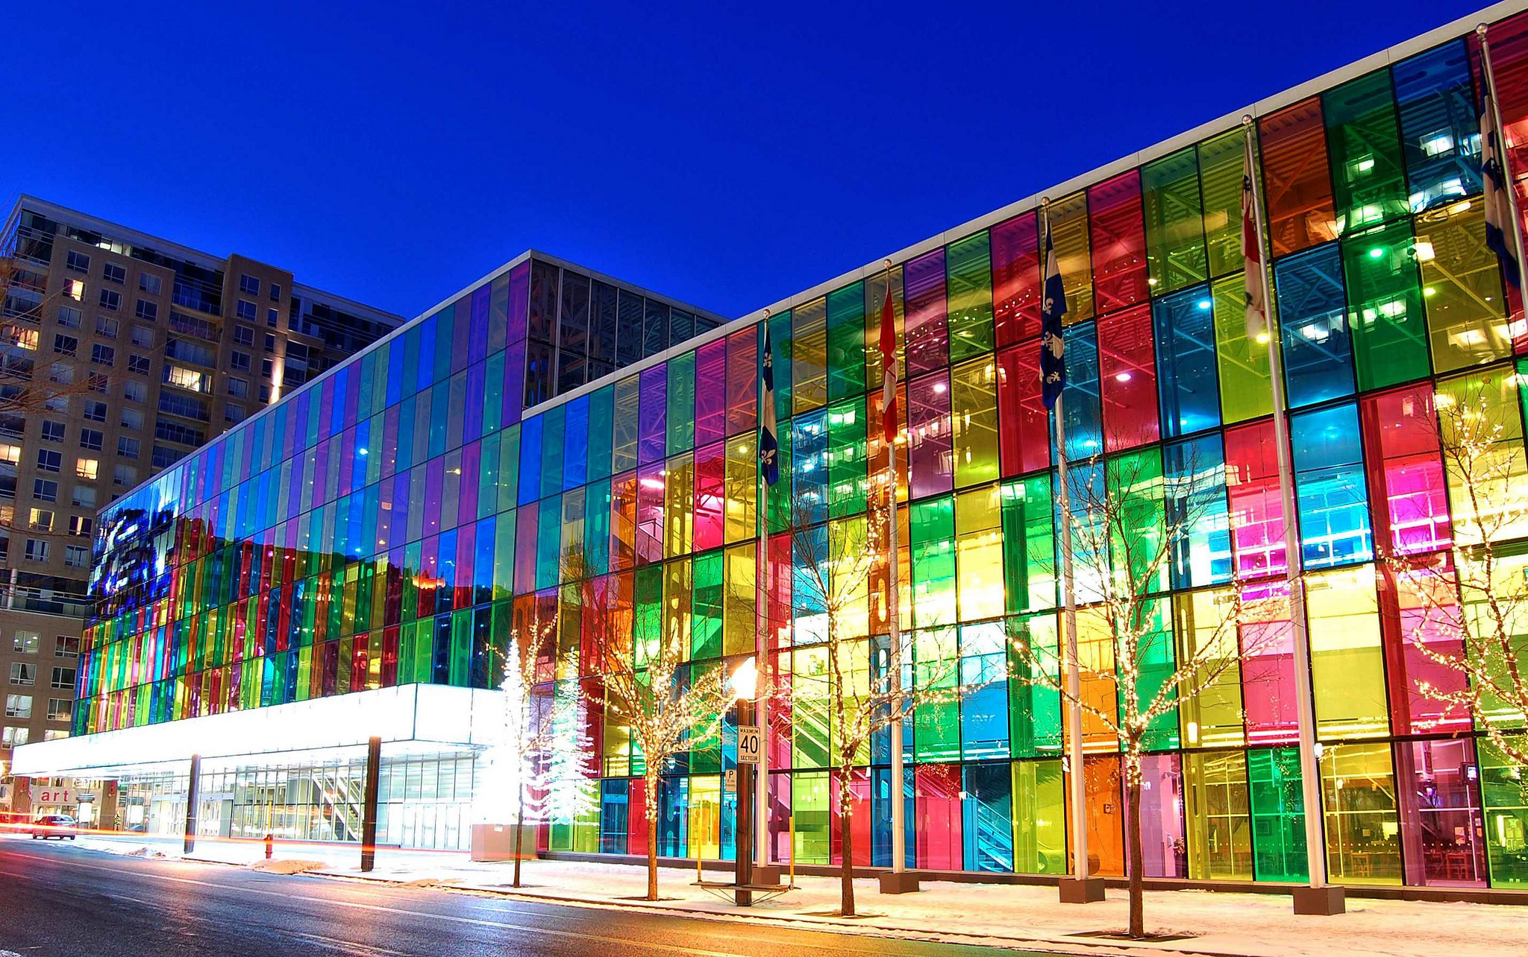
2025 Annual Conference and Exposition
ENGINEERING AND PUBLIC POLICY DIVISION
ANNUAL BUSINESS MEETING

Slide 2
AGENDA
1. Welcome and Introductions
Officers
Executive Committee
2. Conference Program: Number of sessions and papers
3. Update on Website
4. Review of current membership and financial summary
5. Proposal: Division Name Change
6. New Business
7. Comments For the Good of the Order

Slide 3
EPP OFFICERS/ PIC OFFICERS
Salvatore Marsico, Chair
Daniel Oerther, Immediate Past-Chair
John Reisel, Treasurer
Hadi Ali, Executive committee
PIC 1 OFFICERS
Elliot Douglas, current
Chris Carr, post conference

Slide 4
Conference Record for 2025
Over 18 Papers submitted
Two Technical Sessions (11)
One Panel Session (1)
One poster Session (2)
Social Event
Community Mixer
EPP Sessions Corporate Sponsor

Slide 5
Website- https://sites.asee.org/
Redesigned
Posts
Career Information
Drawback- unable to access traffic data

Slide 6
Membership and Financials
As of 6/19/2025 – 699 members, 374 registered for Montreal
FY2025 | BASS ASEE Membership Allocation | $632.00
Q1
 | FY25 Field Unit Dues | $0.00
 | FY25 Expenses | ($59.99)
 | Balance as of 12/31/2024 | $1,176.01 | Avaliable
Q2
 | Balance as of 03/31/2025 | $1,176.01 | Avaliable
Notes:
FY 25 Expenses- Software License/Domain Name Registry $59.99, Division does not charge for membership

Slide 7
Proposal- Name Change
Proposal emailed to membership list on 6/17/2025
Name proposed: Engineering, Law, and Public Policy Division
Purpose-
Align division’s evolving mission
Convergence of engineering, law, and policy
Interdisciplinary approach to address complex technology and to develop legal and regulatory frameworks to shape public policy.

Slide 8
New Business
Division Name Change- Electronic voting upcoming
Bylaws update
Increase executive committee membership
Increase membership participation

Slide 9
Comments
Engineering deans' council- 2026 Panel Session (Deanna)
Sponsored sessions or co-locate (Chris Carr, Incoming PIC 1 Chair)
Theme of 2026 Division Sessions– TBD
Engineering and Public Policy Modules to develop – Shams Bhada, Hadi Ali
Future Webinar Topic – Engineering noun (Dan Oerther)
IN ATTENDANCE- Elliot Douglas, Chris Carr, Deanna Matthews, Dan Oerther, John Reisel, Salvatore Marsico, Shams Bhada

